Slide 1



STUDIO SHODWE
NEXTGEN Tech
Submitted To: Mr. Zahid Javed

Slide 2

STUDIO SHODWE
Group Members
Maryam Sameen 22-NTU-CS-1354
Muhammad Kaif 22-NTU-CS-1364
Muhammad Abdullah 22-NTU-CS-1358
PAGE
02/15

Slide 3



STUDIO SHODWE
INTRODUCTION
NextGen Tech is a modern, scalable web platform built to empower early-stage startups by providing a professional digital presence.
Designed using cutting-edge technologies like Next.js and TypeScript, the platform enable startups to:
Showcase their services
Engaging with users and investors
Streamline lead generation
With its clean UI, responsive design, and modular architecture, NextGen Tech serves as a powerful launchpad for innovation in the digital space.
PAGE
03/15

Slide 4

STUDIO SHODWE
Digital Empowerment
OUR VISION
We aim to simplify the process of establishing an impactful, online presence, giving startups the tools they need to thrive from day one.
Scalable and future-ready solutions
Our platform is designed to grow with startups, supporting evolving needs through modular design, performance optimization, and integration capabilities.
6AGE
07/15

Slide 5


STUDIO SHODWE
Modern UI/UX
Component-based architecture
Easy Deployment
Objective & Goals
Provides a sleek, intuitive interface that enhances user experience and engagement.
Enables reusability and maintainability through modular design.
Supports fast, environment-specific deployment with minimal configuration.
PAGE
04/15

Slide 6

STUDIO SHODWE
KEY TECHNOLOGIES
Node.js (Backend)
Handles API requests efficiently using non-blocking, event-driven architecture.
Next.js (Frontend)
Enables fast, SEO-friendly web apps with server side and static rendering.
MongoDB + Mongoose (Database)
Flexible NoSQL storage with schema-based validation and seamless integration
Provides out-of-the-box user authentication, session management, and role-based access with OAuth and JWT support.
Clerk Authentication
Built-in API routes
Facilitates backend logic (e.g., contact from handling) within the same codebase.
6AGE
08/15

Slide 7
STUDIO SHODWE
Features
Landing Page with CTA
Reusable Component System
Middleware based routing
Features a clean homepage with CTA buttons like “Get Started,” or “Contact Us” to drive user engagement and lead generation.
Uses modular components like buttons, cards, forms across pages, enabling rapid development and consistent design.
Incorporates custom middleware to manage conditional routing, (e.g., access control), laying the groundwork for future features like protected rules.
6AGE
11/15

Slide 8


STUDIO SHODWE
UI Highlights
Landing Page: Hero, CTAs, Sliders
Login/Sign up: Google & email support
Startups: Grid view (AI, DevOps, Cybersecurity)
Contact Form: Clean, accessible support
Admin Panel: Dashboard, Responses, Blogs
6AGE
13/15

Slide 9

STUDIO SHODWE
Target Audience
Startup Founders
Need a reliable platform to validate ideas and attract users or investors.
Tech Team and Developers
Benefit from a codebase that accelerates feature development.
Clients and Visitors
Explore Services and connect with startups through a fast user-friendly interface.
Investors and incubators
Assess the startup’s technical maturity and online presence before engagement.
PAGE
05/15

Slide 10


STUDIO SHODWE
Limitations
Scalability Concerns: Without optimization, MongoDB queries and API routes may slow down with high data volume.
No Native Mobile App: While responsive, the platform lacks a dedicated app experience for mobile users.
Single Language Support: Currently limited to only one language, which restricts to global or local audience approach.
6AGE
06/15

Slide 11


STUDIO SHODWE
FUTURE DEVELOPMENTS
Mobile App Development
Multilingual Support
Admin Analytics Dashboard
AI-Powered Inquiry Analysis
6AGE
12/15

Slide 12
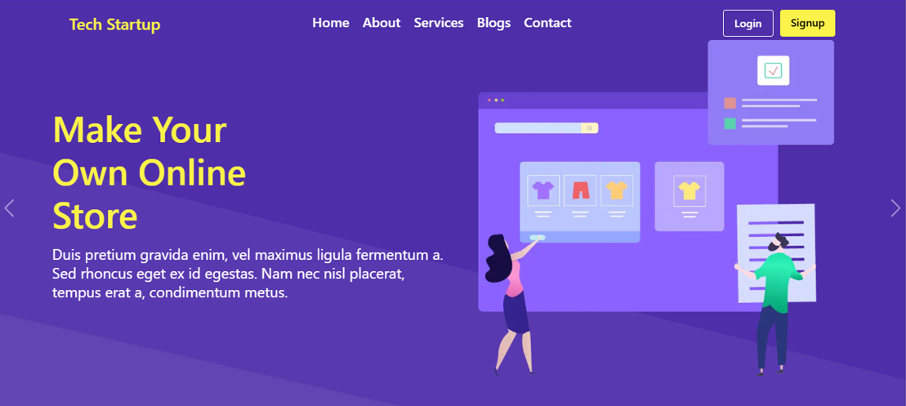
STUDIO SHODWE
Conclusion
NextGen Tech serves as a dynamic and scalable web platform designed to empower early-stage startups with a strong digital presence. Built with modern technologies like Next.js, MongoDB, and Clerk, it offers a seamless user experience, responsive design, and modular architecture. While it currently focuses on core functionalities, its structure is future-ready—allowing for easy integration of advanced features like CMS, mobile apps, and analytics. By combining performance, flexibility, and user-centric design, NextGen Tech lays a solid foundation for startups to grow, engage audiences, and innovate with confidence.
6AGE
09/15

Slide 13

STUDIO SHODWE
THANK YOU!
https://tech-startup-nu.vercel.app/
PAGE
15/15

